Slide 1
The divisions of the nervous system: central and peripheral (somatic and autonomic).
The structure and function of sensory, relay and motor neurons. The process of synaptic transmission, including reference to neurotransmitters, excitation and inhibition.
The function of the endocrine system: glands and hormones.
The fight or flight response including the role of adrenaline.
Localisation of function in the brain and hemispheric lateralisation: motor, somatosensory, visual, auditory and language centres; Broca’s and Wernicke’s areas, split brain research. Plasticity and functional recovery of the brain after trauma.
Ways of studying the brain: scanning techniques, including functional magnetic resonance imaging (fMRI); electroencephalogram (EEGs) and event-related potentials (ERPs); post-mortem examinations.
Biological rhythms: circadian, infradian and ultradian and the difference between these rhythms.
  The effect of endogenous pacemakers and exogenous zeitgebers on the sleep/wake cycle.

Slide 2
Hemispheric lateralisation
The human brain is divided into two hemispheres - left and right hemispheres. Lateralization of brain function means that there are certain mental processes that are mainly specialized to one side or the other.
Most mental functions are distributed across the hemispheres but there are specific processes that are specialized to one hemisphere. For example, both sides of the brain perform functions related to language. But in most people, grammar and vocabulary are localized to the left side of the brain, while understanding the emotional content of language is a function of the right hemisphere.

Slide 3
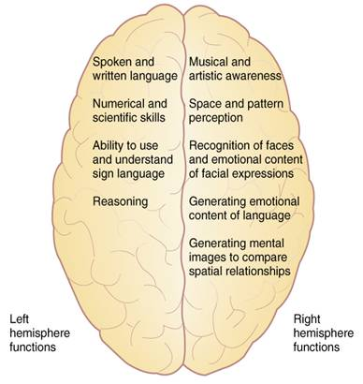

Slide 4
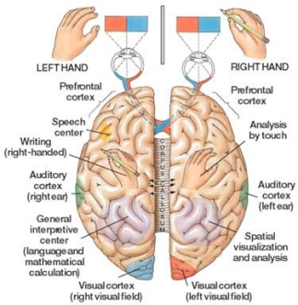

Slide 5
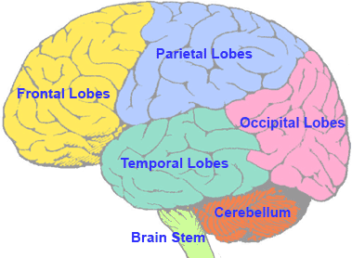
Lobes (clues)

Slide 6
motor
Almost all of behaviour involves motor function, from talking to gesturing to walking. But even a simple movement like reaching out to pick up a glass of water can be a complex motor task to study. Not only does your brain have to figure out which muscles to contract and in which order to steer your hand to the glass, it also has to estimate the force needed to pick up the glass. Other factors, like how much water is in the glass and what material the glass is made from, also influence the brains calculations. Not surprisingly, there are many anatomical regions which are involved in motor function.

Slide 7
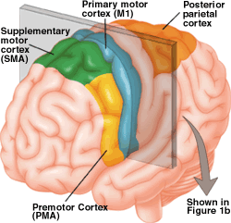
Primary motor Cortex

Slide 8
Primary Motor Cortex
The role of the primary motor cortex is to generate neural impulses that control the execution of movement. Signals from M1 cross the bodys midline to activate skeletal muscles on the opposite side of the body, meaning that the left hemisphere of the brain controls the right side of the body, and the right hemisphere controls the left side of the body. Every part of the body is represented in the primary motor cortex, and these representations are arranged somatotopically — the foot is next to the leg which is next to the trunk which is next to the arm and the hand. The amount of brain matter devoted to any particular body part represents the amount of control that the primary motor cortex has over that body part. For example, a lot of cortical space is required to control the complex movements of the hand and fingers, and these body parts have larger representations in M1 than the trunk or legs, whose muscle patterns are relatively simple.

Slide 9
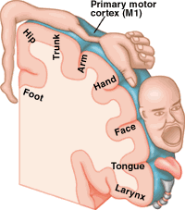

Slide 10
Somatosensory
Catch-all term to designate senses other than vision, hearing, balance, taste and smell. Receptors that could be designated "somatosensory" are distributed all over the body rather than concentrated at specific locations.

Slide 11
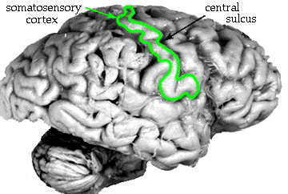

Slide 12
Somatosensory
The first modality is called discriminative touch, which includes touch, pressure, and vibration perception, and enables us to "read" raised letters with our fingertips, or describe the shape and texture of an object without seeing it. The second grouping is pain and temperature, which is just what it sounds like, and also includes the sensations of itch and tickle. The third modality is called proprioception, and includes receptors for what happens below the body surface: muscle stretch, joint position, tendon tension, etc. This modality primarily targets the cerebellum, which needs minute-by-minute feedback on what the muscles are doing.

Slide 13
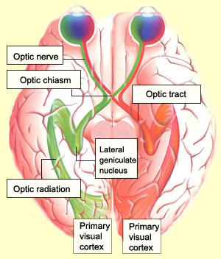
Visual (Occipital lobe)

Slide 14
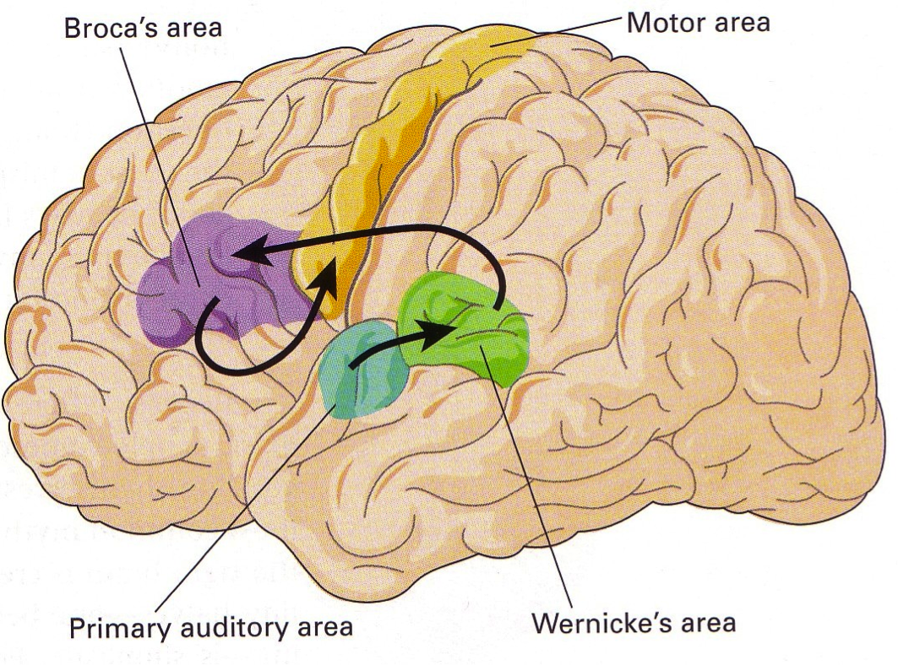
Auditory

Slide 15
Wernicke area
This area was first described in 1874 by German neurologist Carl Wernicke. The Wernicke area is located in the posterior third of the upper temporal convolution of the left hemisphere of the brain. Thus, it lies close to the auditory cortex. This area appears to be uniquely important for the comprehension of speech sounds and is considered to be the receptive language, or language comprehension, centre.
Damage to the temporal lobe may result in a language disorder known as Wernicke aphasia. An individual with Wernicke aphasia has difficulty understanding language; speech is typically fluent but is empty of content and characterized by circumlocutions, a high incidence of vague words like “thing,” and sometimes neologisms and senseless “word salad.”
[Credit: Encyclopædia Britannica, Inc.]

Slide 16
Language
A century and a half ago, French physician Pierre Paul Broca found that patients with damage to part of the brain’s frontal lobe were unable to speak more than a few words. Later dubbed Broca’s area, this region is believed to be critical for speech production and some aspects of language comprehension.
However, in recent years neuroscientists have observed activity in Broca’s area when people perform cognitive tasks that have nothing to do with language, such as solving math problems or holding information in working memory. Those findings have stimulated debate over whether Broca’s area is specific to language or plays a more general role in cognition.

Slide 18
Split brain research
Show through experiment.
Corpus Colosseum
https://www.youtube.com/watch?v=MZnyQewsB_Y

Slide 19
Split brain
Sperry’s research (1960’s and 1970’s) revealed that when the two hemispheres of the brain are disconnected, they become functionally separate. Studies of patients whose corpus callosum had been severed, disconnecting the left and right halves of the brain, revealed this insight. Click here for more on lateralisation and the procedures and findings of the experiments.
Watch this video for a demonstration of the experiments.
Neuro-myths
In an article entitled “Right Brained, Wrong Brained: How Caltech Neuroscience became a Buzzfeed Quiz” (Los Angeles Magazine, Feb 9th 2015), author Jason G. Goldman highlights the inappropriate use of Sperry’s research to suggest that people can be left or right brained. The idea that people can be categorised as being one or the other, to account for our strengths and weaknesses, is a neuro-myth. The article points about that the brain needs both sides to function but that both sides need the corpus callosum to communicate. The misreporting of the findings – and a human need to find ways to explain and predict our success and failures – seems to be responsible for the widespread misuse of this finding. The idea of right or left “brained-ness” is popular probably because it seems more scientific than horoscopes or out-dated personality classifications.
Follow this link for more about this myth.
“”The great pleasure and feeling in my right brain is more than my left brain can find the words to tell you.”

Slide 20
Plasticity and functional recovery of the brain after trauma.
Introduction
http://www.bbc.co.uk/news/health-35595086

Slide 21
What is Brain Plasticity?
Brain plasticity—also called neuroplasticity - is an odd term for most people, with the word "plastic" causing images of Tupperware or Saran Wrap to pop into your head. However, brain plasticity is a common term used by neuroscientists, referring to the brain's ability to change at any age – for better or worse. As you would imagine, this flexibility plays an incredibly important role in our brain development (or decline) and in shaping our distinct personalities.
How the Brain Changes
Brain plasticity science is the study of a physical process. Gray matter can actually shrink or thicken; neural connections can be forged and refined or weakened and severed. Changes in the physical brain manifest as changes in our abilities. For example, each time we learn a new dance step, it reflects a change in our physical brains: new "wires" (neural pathways) that give instructions to our bodies on how to perform the step. Each time we forget someone's name, it also reflects brain change— "wires“ that once connected to the memory have been degraded, or even severed. As these examples show, changes in the brain can result in improved skills (a new dance step) or a weakening of skills (a forgotten name)

Slide 22
Neuroplasticity
Neuroplasticity, also known as brain plasticity, is an umbrella term that describes lasting change to the brain throughout an animal's life course. The term gained prominence in the latter half of the 20th century, when new research showed many aspects of the brain remain changeable (or "plastic") even into adulthood. This notion contrasts with the previous scientific consensus that the brain develops during a critical period in early childhood, then remains relatively unchangeable (or "static") afterward. Neuroplastic change can occur at small scales, such as physical changes to individual neurons, or at whole-brain scales, such as cortical remapping in response to injury.[ Behavior, environmental stimuli, thought, and emotions may also cause neuroplastic change, which has significant implications for healthy development, learning, memory, and recovery from brain damage.
Neuroscientists distinguish synaptic plasticity, which refers to changes in how neurons connect to each other, from non-synaptic plasticity, which refers to changes in the neurons themselves.

Slide 23
Doidge
https://www.youtube.com/watch?v=ifYcE4-eI_s
Intense dedication is a hallmark of those who, all on their own, accomplish large-scale change in their brains. John Pepper, a South African now in his late seventies, was diagnosed in his thirties with the incurable, chronic, progressive neurodegenerative disease known as Parkinson’s. By all odds he should be immobile, if not dead, by now, but Pepper has fought his symptoms to a standstill by vigorous exercise carried out with ferocious determination and conscientious attention to detail. “Even as his unconscious ability to walk unravelled,” Doidge explains, “Pepper realized that if he analyzed how he walked and used his conscious mind to guide him, he could still do it. So he used a different part of his brain, the frontal lobes, and—like a child learning to walk—thought himself into efficient walking.”
http://www.macleans.ca/society/health/how-your-brain-heals-itself/

Slide 24
Draganski et al (2006) German medical students and revision
Luke and Georgi?

Slide 25
Treatment of brain damage Nudo group research on stroke recovery, Phillips (2006) case study of recovery from a coma after 19 years.
Veronica

Slide 26
Notes
Plasticity
How the Brain Changes
Brain plasticity science is the study of a physical process. Gray matter can actually shrink or thicken; neural connections can be forged and refined or weakened and severed. Changes in the physical brain manifest as changes in our abilities. For example, each time we learn a new dance step, it reflects a change in our physical brains: new "wires" (neural pathways) that give instructions to our bodies on how to perform the step. Each time we forget someone's name, it also reflects brain change— "wires“ that once connected to the memory have been degraded, or even severed. As these examples show, changes in the brain can result in improved skills (a new dance step) or a weakening of skills (a forgotten name)

Slide 27
Increased Brain Stimulation
Molly and Savanna

Slide 28
Axon Sprouting
Terry and Sam

Slide 29
Denervation supersensitivity
Axons that do a similar job to those that are damaged become more sensitive. This can have the negative effect of making the person more sensitive to aspects that they were not previously eg: ‘over’ sensitive to pain.

Slide 30
Functional recovery after Trauma
Factors effecting:
Perserverance
Lottie and Cameron

Slide 31
Physical stress exhaustion and Booze!
Esme And Olivia

Slide 32
Age and Gender
Niamh and Abi

